Slide 1
Presentation Slides for
Project 2 Part 5
Part-Time Data Science
Predictive Maintenance Data
By Vj Esguerra
Submitted: 10/3/21

Slide 2
Agenda
Introduction
Exploratory Visuals
Production Models Used
Final Recommendations

Slide 3
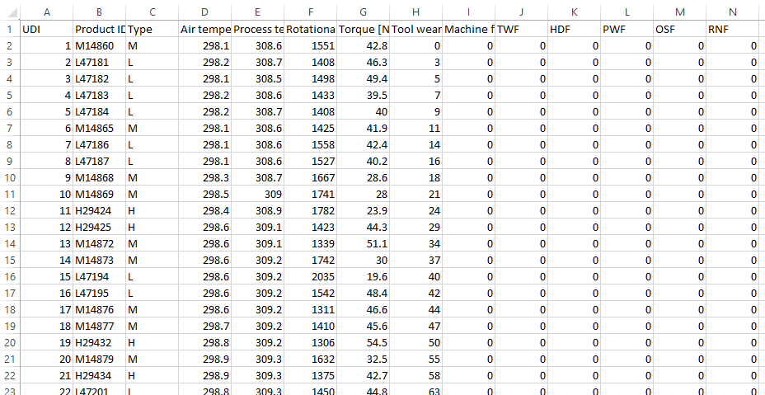
Introduction
Data used in this project are from the predictive maintenance dataset located here:
UCI Machine Learning Repository: AI4I 2020 Predictive Maintenance Dataset Data Set (https://archive.ics.uci.edu/ml/datasets/AI4I+2020+Predictive+Maintenance+Dataset)

Slide 4
Introduction
What is this data set?
10,000 data points
Includes measurements such as air temperature, rotational speed, tool wear
Indicates whether a specific machine has failed
What is the machine learning problem?
Given the data set, which machine learning model successfully predicts machine failure?

Slide 5
Introduction
Why this data set?
Related to my industry (I work in commercial aviation)
Replacement for original data set on airplane safety (from FiveThirtyEight web site article) that was not compatible with the project requirements
What is predictive maintenance?
“Predictive maintenance techniques are designed to help determine the condition of in-service equipment in order to estimate when maintenance should be performed. This approach promises cost savings over routine or time-based preventive maintenance, because tasks are performed only when warranted. Thus, it is regarded as condition-based maintenance carried out as suggested by estimations of the degradation state of an item… Predictive maintenance differs from preventive maintenance because it relies on the actual condition of equipment, rather than average or expected life statistics, to predict when maintenance will be required. Typically, Machine Learning approaches are adopted for the definition of the actual condition of the system and for forecasting its future states.”
“Predictive maintenance”
Wikipedia entry
(https://en.wikipedia.org/wiki/Predictive_maintenance)

Slide 6
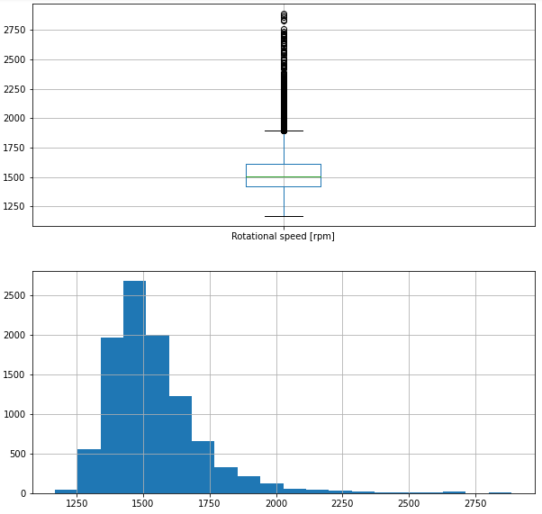
Exploratory Visuals
Several boxplots and histograms were created to visualize the numerical data:
Boxplots aided in the identification of outliers as well as the distribution of the data.
Histograms provided a count of the occurrence of each data value which helped in discerning trends.
Key findings (Rotational speed):
Rotational speed had several instances of machines performing beyond the upper limits expected statistically about 1875 rpm.
Rotational speed values tended to be concentrated between about 1250 and 1875 rpm (“positive skew”).

Slide 7
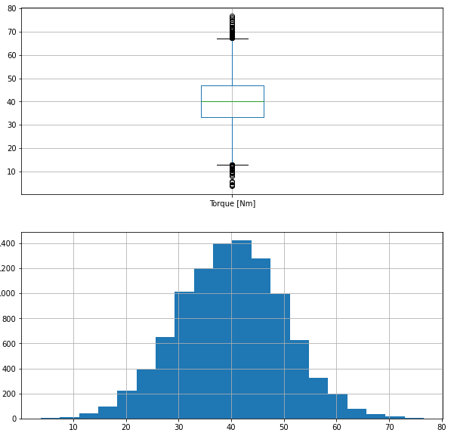
Exploratory Visuals
Several boxplots and histograms were created to visualize the numerical data:
Boxplots aided in the identification of outliers as well as the distribution of the data.
Histograms provided a count of the occurrence of each data value which helped in discerning trends.
Key findings (Torque):
Torque had several instances of values beyond lower and upper limits expected statistically.
Torque values were concentrated between about 12 Nm and 67 Nm (“symmetric”).

Slide 8
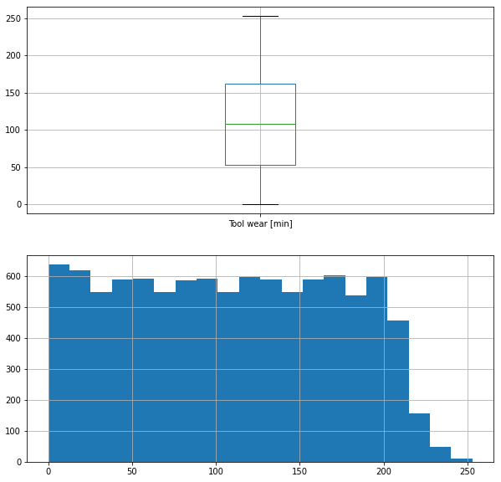
Exploratory Visuals
Several boxplots and histograms were created to visualize the numerical data:
Boxplots aided in the identification of outliers as well as the distribution of the data.
Histograms provided a count of the occurrence of each data value which helped in discerning trends.
Key findings (Tool wear):
Tool wear values seem to fit within expected upper and lower statistical limits (no outliers).
Tool wear values mostly seemed not to exceed about 200 minutes (“uniform distribution”)

Slide 9
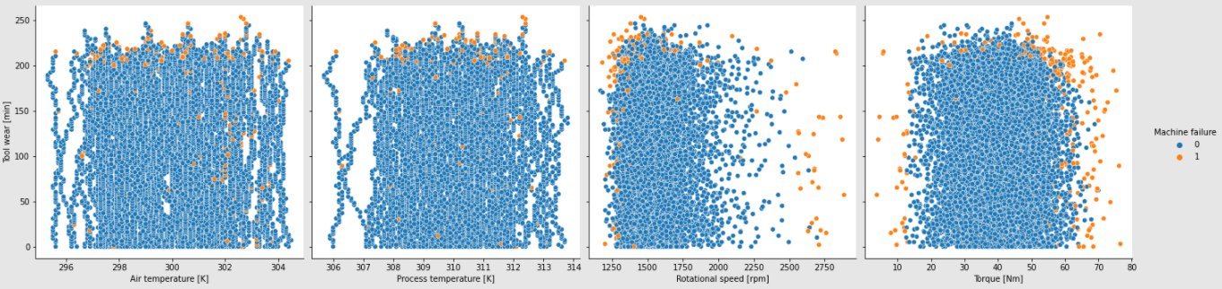
Exploratory Visuals
Pairplots and scatterplots were created to visualize the numerical data. Key findings include:
Machine failures tended to occur above 200 minutes of tool wear over a broad air temperature range (roughly 296 K to 304 K), with a notable cluster of failures around 302 K air temperature (see first scatterplot).
Machine failures tended to occur above 200 minutes of tool wear over a broad process temperature range (roughly 307 K to 312 K) (see second scatterplot).
Machine failures tended to occur over a broad timespan from right after machine start (less than 1 minute) to 250 minutes, with rotational speeds mostly within the 1250 rpm to just below 2000 rpm range then again between 2500 rpm to above 2750 rpm (see third scatterplot).
Machine failures tended to occur over a broad timespan from right after machine start (less than 1 minute) to 250 minutes, with torque values between 10 Nm and just below 80 Nm (see fourth scatterplot).

Slide 10
Production Models Used
Since we’re trying to determine whether a machine will fail or not (“binary classification”), and we have a data set with 10,000 data points and (after data cleaning) 7 relevant variables, the following production models were used:
Logistic regression (GridSearchCV-tuned)
Train/test accuracy: 96.867% / 97.44%
KNearestNeighbors (KNN) (GridSearchCV-tuned)
Train/test accuracy: 98.173% / 97.84%
Gradient Boost / LGBM / XGB
Train/test accuracy: 99.2% / 98.56%
Train/test accuracy: 100%* / 98.52%
Train/test accuracy: 98.93% / 98.56%
*This is called “overfitting the model”

Slide 11
Final Recommendations
Based on performance of the gradient boost model (train/test accuracy: 99.2% / 98.56%), it appears to be the best model to predict machine failure.
I recommend using it over the next year to identify machines that could possibly fail.

